Slide 1
HEART attack PREDICTION
BY SHRAVYA MOTAMARY(160114737025)
&
SINDHUJA REDDY KAMIDI(160114737027)

Slide 2
agenda:
Introduction
Software and hardware requirements
Machine learning
Implementation
CNN algorithm
Results
Conclusion and Future scope

Slide 3
introduction
Health checkup every 6 months
Work is done manually
Prediction is done by specialists based on the previous experience and data collected
Involving machine in even predicting makes work more easy , fast and effective.
Our project predicts the stage of severity of heart attack that may prone.

Slide 4
Software requirements:
Octave tool version 3.6.4
JDK for interface
ALGORITHMS IMPLEMENTED:
gradient descent
Cellular neural network(CNN)
Machine learning concepts
Languages involved: java, basic math, predefined packages in octave.

Slide 5
Hardware requirements:
Windows XP operating system
Processor
Memory (35MB)

Slide 6
Machine learning
Defining machine learning.
Applications:
Computer vision
Hadoop
Data mining …….
Supervised and unsupervised learning
Supervised: regression and classification

Slide 7
Supervised:
Regression:
We try to predict the continuous value of output.
-E. g. House prices
Classification: Discrete value output(0 or 1)
-E. g. To predict type of tumor.

Slide 8
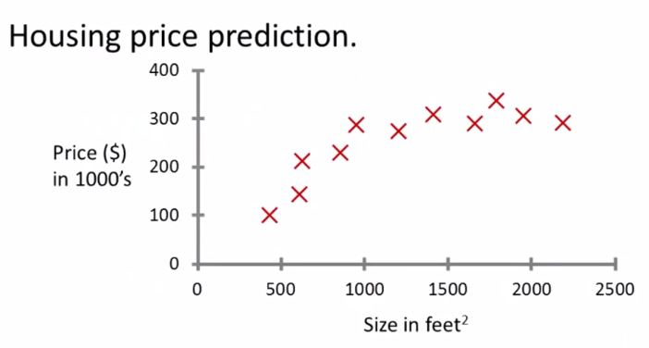

Slide 9
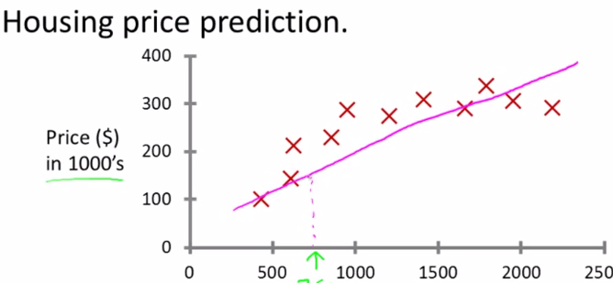

Slide 10
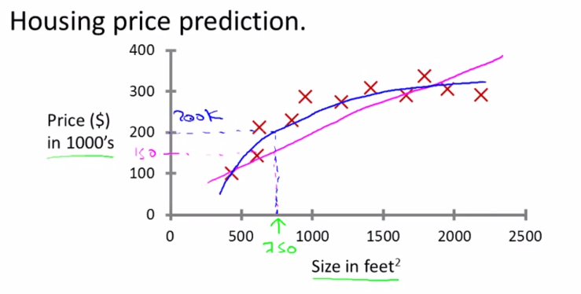
Term supervised learning refers to the fact that we gave the algorithm a dataset in which right answers were given.

Slide 11
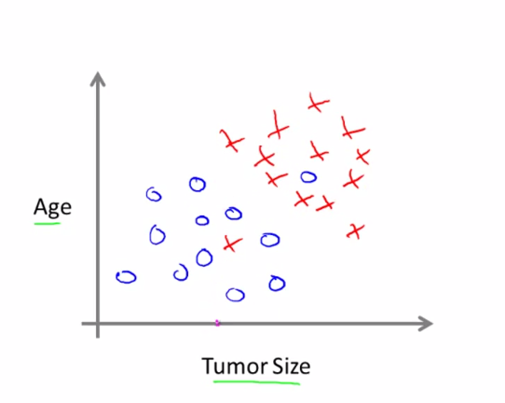
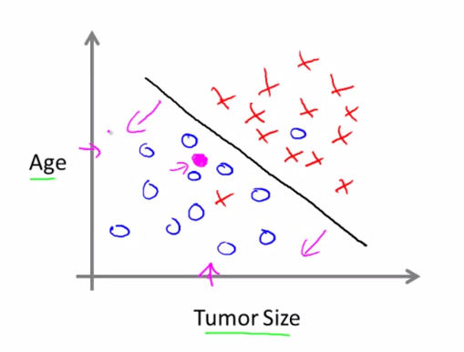
Classification problem

Slide 12
Unsupervised learning
Unsupervised learning allows us to approach problems with little or no idea what our results should look like. We can derive structure from data where we don't necessarily know the effect of the variables.
We can derive this structure by clustering the data based on relationships among the variables in the data.
Examples
Google
DNA
Cocktail party

Slide 13
Octave
Open source
General Arithmetic operations
Saving variables
Save filename variablename
By default it will store with .m extention
Arrays and vectors
Zeros(x,y)
Control statements
Functions
Fn[o1,o2,…..]=name(i1,i2…)

Slide 14
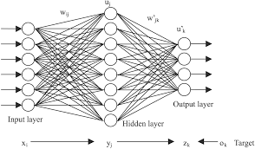
Cellular neural network:

Slide 15
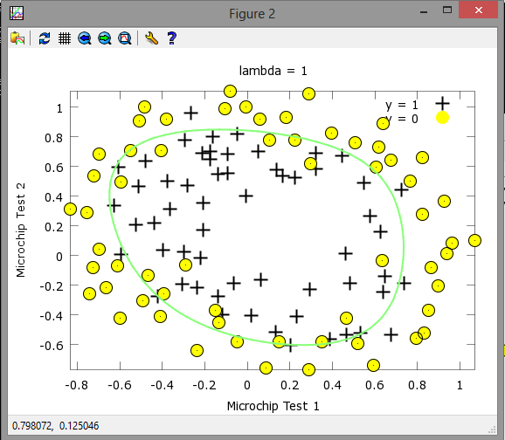
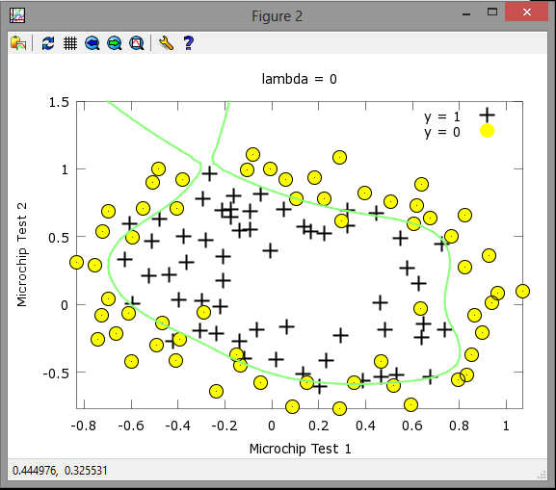
Regularization:

Slide 16
Implementation:
Random theta values
epsilon_init = 0.12;W = rand(L_out, 1 + L_in) * 2 * epsilon_init - epsilon_init;
Loading the dataset
Load(xyz.dat);
Predicting:
h1 = sigmoid([ones(m, 1) X] * Theta1');h2 = sigmoid([ones(m, 1) h1] * Theta2');[dummy, p] = max(h2, [], 2);p=p-1;

Slide 17
Forward propagation:
Activation values from Theta and input
Sigmoid gradient
Hypothesis finding
Cost function formula

Slide 18
Back propagation
Used to find the gradient value
Error for hypothesis
Back propagation errors to each individual activation
Finding delta
Gradient from finding

Slide 19
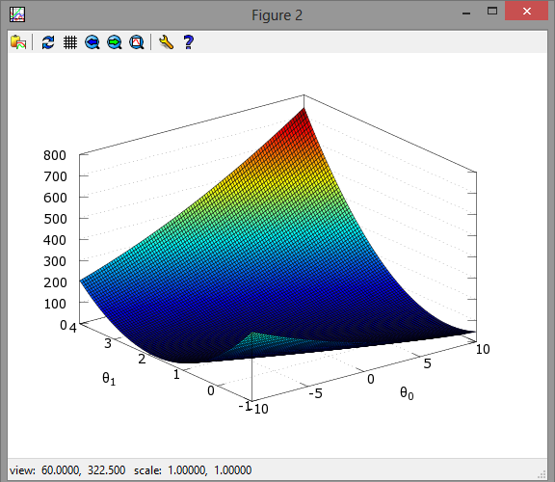
Plotted graph:

Slide 20
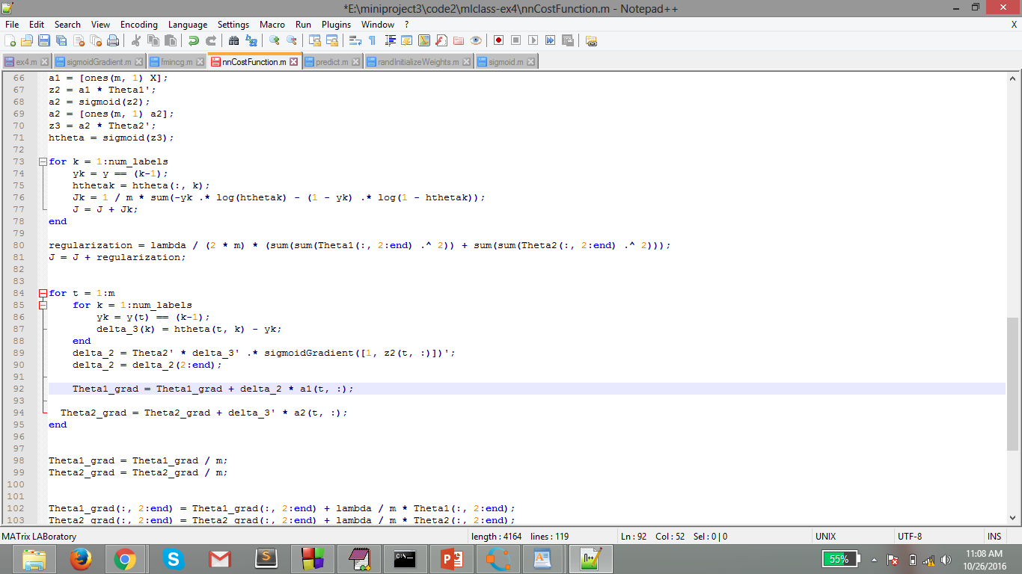
costFunction

Slide 21
Inputs:
Attribute Information:
Only 14 attributes used: 1. (age) 2. (sex) 3. (cp ) ( chest pain type -- Value 1: typical angina -- Value 2: atypical angina -- Value 3: non-anginal pain -- Value 4: asymptomatic ) 4. (trestbps ) resting blood pressure 5. (chol ) 6. (fbs) blood suger level 7. (restecg ) cardiographic results 8. (thalach ) maximum heart rate achieved 9. (exang ) exercise 10. (oldpeak) 11. (slope) 12. (ca) number of major blood vessels 13. (thal) 14. (num) (the predicted attribute)

Slide 22
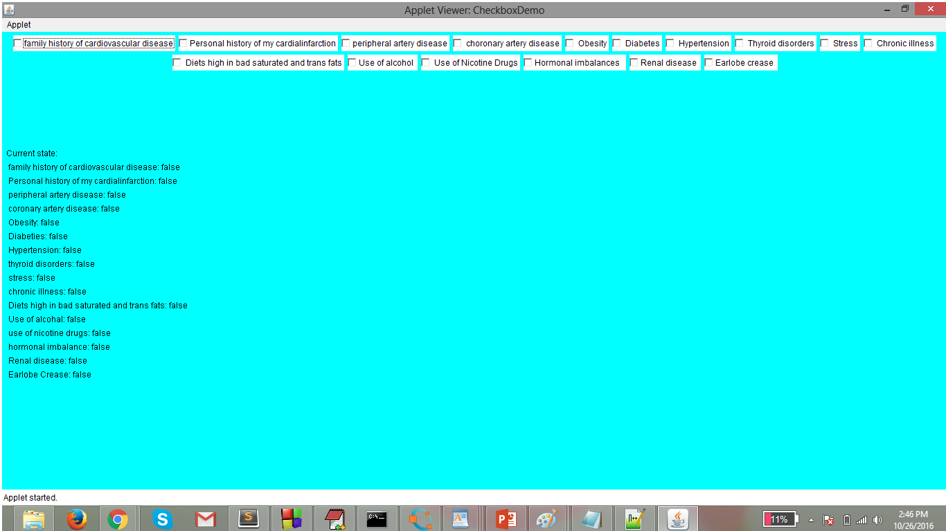

Slide 23
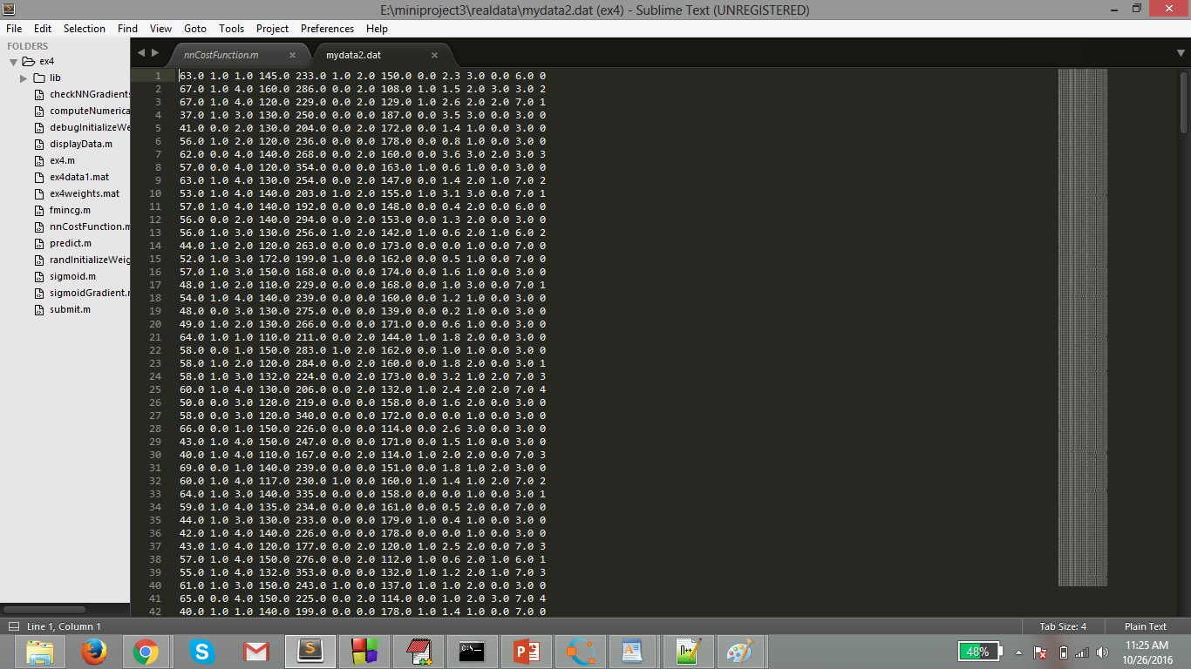
Dataset:

Slide 24
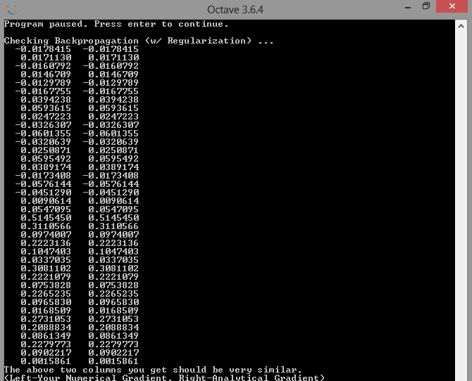
Output:

Slide 25
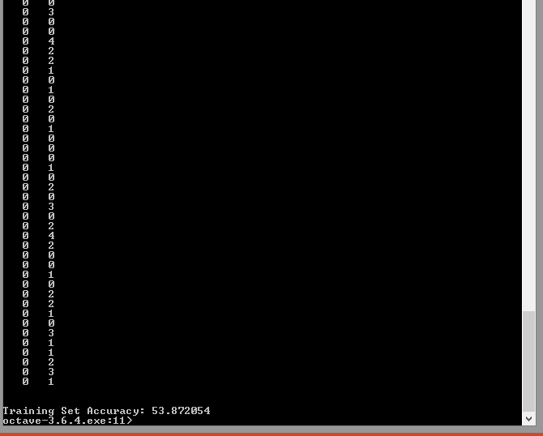
Output:
It gives the accuracy and also the stage of the heart attack that is predicted

Slide 26
Advantages and disadvantages:
It is more accurate and efficient
It gives most fastest prediction
Disadvantages:
We can’t replace a man with machine(cannot predict 100% accurate)

Slide 27
Conclusion:
Can predict the severity of attack
More accuracy and efficient

Slide 28
future scope:
Can include the age prediction when the attack may prone
Can increase more accuracy
Can also include the genetic information to predict

